Slide 1
Task Force on Review of School Curriculum
Initial Recommendations
Dr Anissa CHAN
6 January 2020

Slide 2
Main Scope of Work
To holistically review the primary and secondary curricula and to make directional recommendations on the following:
  how the school curricula at primary and secondary levels can be rigorous and forward-looking in enhancing students’ capacity to learn and instill in them the values and qualities desired for students of the 21st century to meet future challenges as well as the needs of society;
  how to better cater for students’ diverse abilities, interests, needs and aspirations;
  how to optimise the curriculum in creating space and opportunities for students’ whole-person development; and
  how to better articulate learning at the primary and secondary levels.

Slide 3
Progress Report
Examined the present state of curriculum implementation in Hong Kong in the wider context of regional developments
Continuously engaged key stakeholder groups and collected their views
Formulated a set of initial recommendations categorised under six directions for public consultation (28 June – 16 Oct 2019) after in-depth discussion on the views and suggestions collected
Will finalise the directional recommendations and submit them to the Government by the end of 2019 or early 2020

Slide 4
Initial Recommendations
Whole-person Development
Values Education
Creating Space & Catering for Learner Diversity
Applied Learning
University Admissions
STEM Education

Slide 5

Whole-person Development
Enhance curriculum planning to create space and provide a wider range of learning experiences to foster students’ balanced development of attributes in the moral, intellectual, physical, social and aesthetic domains
Create adequate space for students to participate in life-wide learning activities to develop personal strengths/interests (Provision of Life-wide Learning Grant from the 2019/20 school year)
Make better use of whole-day primary schooling and flexibly plan learning time at the secondary level, and step up communication with parents and home-school co-operation to provide students with a learning environment conducive to whole-person education

Slide 6

Examples of Life-wide Learning Activities
Cross-curricular/
theme-based learning
Visits
Non-local learning activities
Education/training camp
Drama/Film appreciation
Competitions
Sports and arts activities

Slide 7
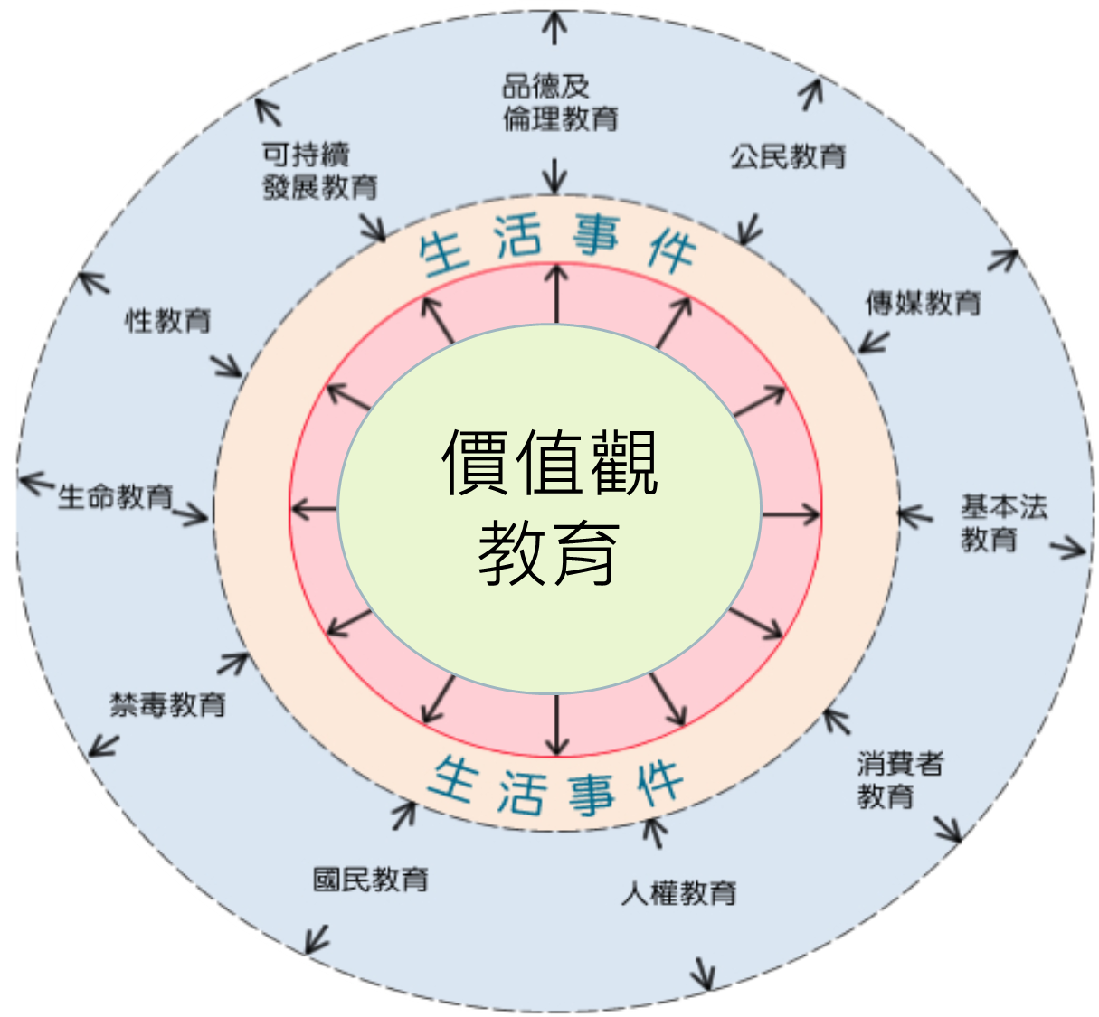
Values Education
Accord higher priority to values education to keep pace with rapid societal changes to address news issues in the digital era
Strengthen Life Education in particular for cultivating students’ resilience, sense of responsibility and ethical values
Start Life Planning Education early at the upper primary and junior secondary levels to help students understand their interests, work ethics and career choices

Slide 8
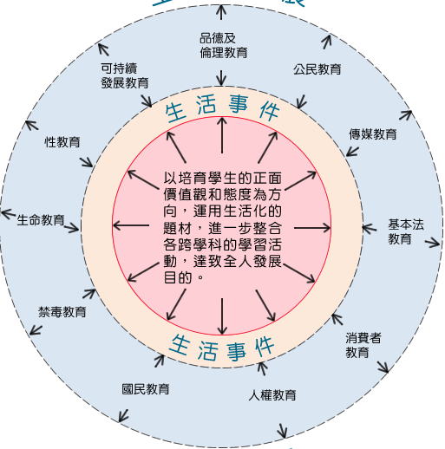
我的行動承諾
價值觀教育
舉隅
生活
事件
生活
事件
全方位
學習活動
價值觀
教育
境外
學習
制服
團隊
生活
事件
服務
學習

Slide 9

Creating Space &
Catering for Learner Diversity
Four core subjects at the senior secondary (SS) level:
Keep intact the status of the four core subjects
Review the design and implementation of the curriculum and assessment and take forward trimming and differentiation to increase curriculum flexibility and create space, hence catering for learner diversity

Slide 10
Initial Recommendation: optimising the Four Core Subjects at the SS Level
Math | Make it clear to schools a good mastery of concepts and skills in the Foundation Topics of the Compulsory Part will be sufficient to score as high as Level 4 in the HKDSE Exam
Liberal Studies | Clarify and streamline the curriculum coverage with clear delineation of the important concepts and content requirements Allow schools/students to opt out of the IES: assessment in the public exam alone can offer the highest attainment of Level 4 in the HKDSE Exam

Slide 11
Initial Recommendation: optimising the Four Core Subjects at the SS Level
Chinese/ English Language | Streamline the number of exam papers and/or SBA Enhance the learning of Chinese literature and classics in the curriculum from the primary level and progressively throughout the secondary level but need to consider how to cater for the learning needs of NCS students of diverse cultural background

Slide 12
Creating Space &
Catering for Learner Diversity
Current framework of the
curriculum and assessment of core subjects
Chinese Language
English Language
Liberal Studies
Math
Modules + IES
Curriculum and Assessment
Curriculum and Assessment
Compulsory
Part
Extended
Part (M1/M2)

Slide 13
Creating Space &
Catering for Learner Diversity
Possible scenarios of trimming and differentiating the core subjects
Sufficient for Level 4
Chinese Language
English Language
Liberal Studies
Math
Curriculum and Assessment
Curriculum and Assessment
Foundation
Topics
Compulsory
Part
M1/
M2
Modules
IES
Non-foundation Topics
Flexible
choice
Optional

Slide 14
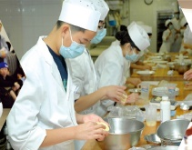
Applied Learning
Further promote Applied Learning (ApL) as a valued SS elective subject
Creative Studies
Media and Communication
Business, Management and Law
Services
Applied Science
Engineering and Production
(e.g. Display and Jewellery Design)
(e.g. Film and Transmedia)
(e.g. Marketing and
Online Promotion)
(e.g. Child Care and Education)
(e.g. Medical Laboratory Science)
(e.g. Aviation Studies)

Slide 15
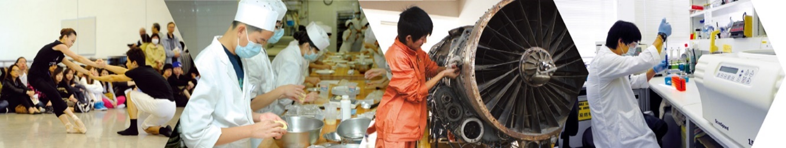
Applied Learning
Increase students’ incentive to take ApL
  Offer ApL as early as in Secondary 4;
  Relax funding eligibility for students taking ApL as the 4th elective subject;
  Provide a wider range of ApL courses;
  Offer taster programmes at the JS level; and
  Encourage tertiary institutions to recognise students’ achievements in ApL when considering them for admission

Slide 16

University Admissions
Maintain General Entrance Requirements (GER) for university admissions (i.e. 3322 in the core subjects)
Encourage universities to exercise greater flexibility in admitting students who demonstrate talents in non-academic areas or through other means but fall short of GER
Encourage universities to expand the view on “merit” by giving greater weight to Student Learning Profile (SLP), Other Experiences and Achievements in Competitions/Activities (OEA) and School Principal’s Nominations (SPN), and more widely adopting admission interviews

Slide 17
University Admissions
The new School Principal’s Nominations 2.0 Direct Admission Scheme
(Initial Thought)
Each secondary school can nominate two students (with outstanding talent in non-academic realms such as sports, arts, leadership and social service) for designated university programmes.
Subsequent to admission interviews, universities can provide a firm offer for nominees suitable for the applied programme before the release of the HKDSE results.
Binding on both students and institutions once students have accepted the firm offer.
(Remarks: Students who are not selected or do not accept the offer could apply for admission again via the JUPAS route.)

Slide 18

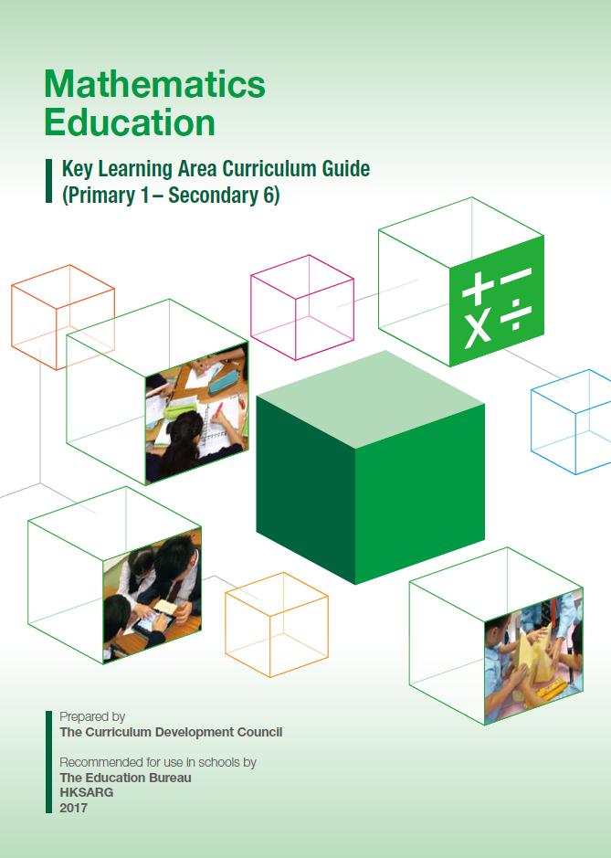
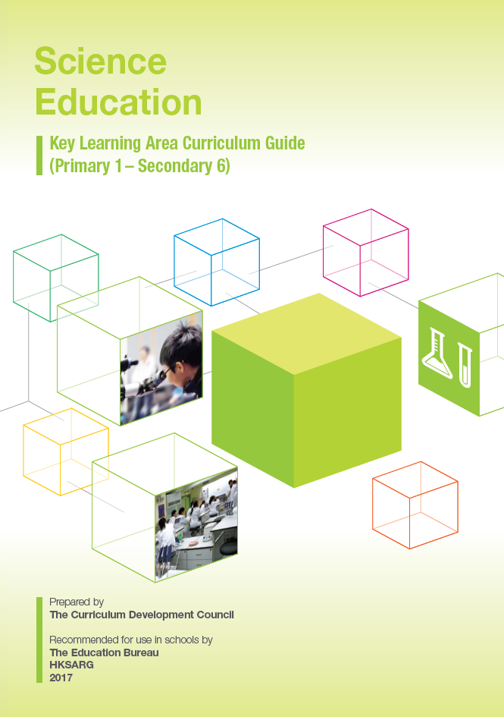
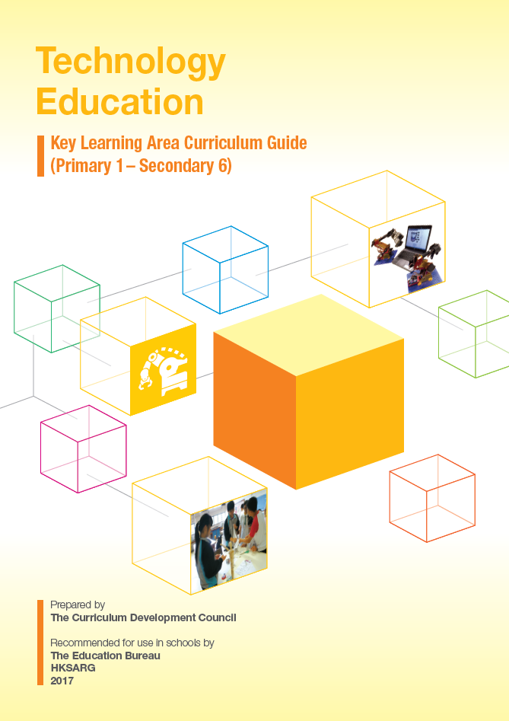
STEM Education
more clearly define STEM education and clarify the expectations of promoting STEM education in primary and secondary schools
18

Slide 19
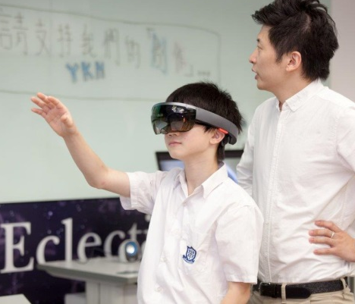
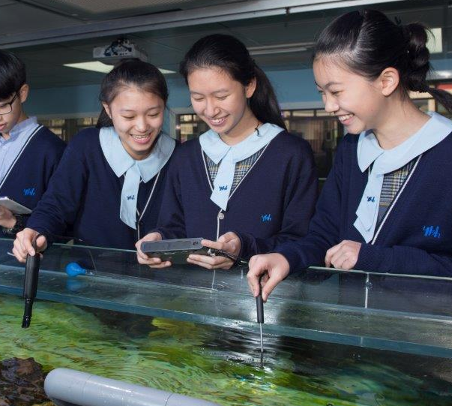
Promoting STEM education: Objectives
STEM Education
Enable students to develop a solid knowledge foundation in Science, Technology and Math KLAs and arouse learning interest
Enhance the ability to integrate and apply knowledge and skills
Foster creativity, collaboration and problem solving skills, innovative thinking and entrepreneurial spirit
Lay a foundation for students to pursue studies and careers in STEM-related fields
  With emphasis on the paradigm shift in learning and teaching and enhancing in particular:
  “student-centred” pedagogy
  “enquiry learning”
  “hands-on” and “minds-on” STEM activities, e.g. enquiry, design and make, project learning

Slide 20
Promoting STEM Education: Objectives
Primary
Develop in students an interest in science and technology and a habit of applying design thinking to create and problem solve
Develop in students a habit of applying knowledge and skills integratively to solve authentic problems
Junior Secondary
Develop a solid knowledge foundation in science, technology and math
Skills in adopting scientific inquiry to acquire knowledge
Senior Secondary
Integrate the learning elements of STEM with existing subjects and enhance the integrated use of knowledge of science, technology and math to solve authentic problems
Skills in applying design thinking to create and problem solve
Help students understand the latest developments in and importance of contemporary science and technology (e.g. artificial intelligence, biotechnology)
Enable students to explore various STEM-related disciplines/careers and get prepared for planning future studies and work

Slide 21
STEM Education
Step up professional support:
  Provide curriculum framework and/or guides as well as more learning and teaching exemplars;
  Enhance the professional capacity of teachers and principals through pre- and in-service training programmes;
  Appoint teachers to serve as STEM co-ordinators at both the primary and secondary levels; and
  Set up local STEM resources centres in different districts
Set up a designated committee under the CDC to oversee the long-term development of STEM education in Hong Kong

Slide 22
Concluding Remarks
Student learning and development needs are at the centre of this curriculum review.
The initial recommendations aim at “fostering whole-person development”, “creating space”, “providing choice” and “meeting future needs and cultivating future-ready attributes”.

Slide 23
Concluding Remarks
The recommendations are interlocking and their effective implementation, which helps create space for students and teachers and cater for diverse learning needs, hinges on the concerted efforts of all and a change in culture in schools and society.
Whole-hearted, concerted efforts of various subjects and other stakeholders to make necessary compromises and changes in areas under their own purview with the aim of benefitting our students are crucial.

